Slide 1

Sprocket Central Pty Ltd
Data analytics approach
Rahul Prasad Sah

Slide 2
Agenda
Introduction
Data Exploration
Model Development
Interpretation

Slide 3
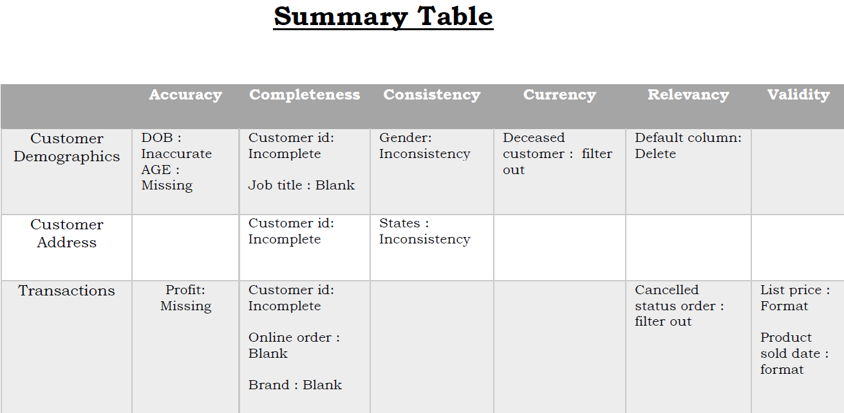
Introduction
Data Quality Assessment and ‘Clean Up’
Key Issue of Data Quality Management :
Accuracy : Correct values
Completeness : Data Fields with values
Consistency : Values free from contradiction
Currency : Values up to Date
Relevancy : Data Items with value meta data
Validity : Data Containing with Allowable values
Uniqueness : Records that are Duplicated
Place any supporting images, graphs, data or extra text here.

Slide 4
Data Exploration
Bike related purchase over last Three Years by Gender
1. Over the last three years total 98359 bike purchased by Females to 93483 bike purchased by Male. And only 3718 bikes were purchased by unknown gender.
2. Females makes up majority of bike related sales.
Place any supporting images, graphs, data or extra text here.

Slide 5
Data Exploration
Job industry Distribution
20 % of New Customer are more in Manufacturing and Financial Services.
The smallest number of customer are 3 % in Agriculture and Telecommunication.
Similar pattern in old customer and new customer in Manufacturing and financial services which is 20 % .
Place any supporting images, graphs, data or extra text here.

Slide 6
Data Exploration
Wealth Segmentation by Age Category
In all age categories the largest numbers of customers are classified as ‘Mass Customer’.
The next category is the ‘High Net Worth’.
The ‘Affluent Customer’ can outperforms the ‘High Net Worth’ customer in the 40-49 age group.

Slide 7
Data Exploration
Numbers of Cars Owned and not Owned by State.
NSW has largest amount of people that do not own a car. It seems to have a highest number of people from which data is collected.
VIC is also split quite evenly. But both numbers are significantly lower than NSW.
QLD has a relatively high number of customers that own a car.

Slide 8
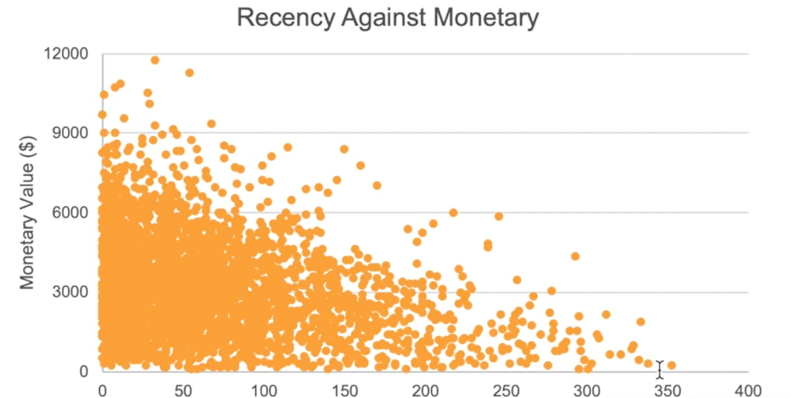
Model Development
Scatter Plot Based on RFM Analysis
This chart shows that the customer who purchased more recently have generated more revenue rather then the customer who visited a while ago.
Customer from recent past (50-100 days) they also generated moderate revenue.
Those who visited more than 200 days ago are generate low revenue.

Slide 9
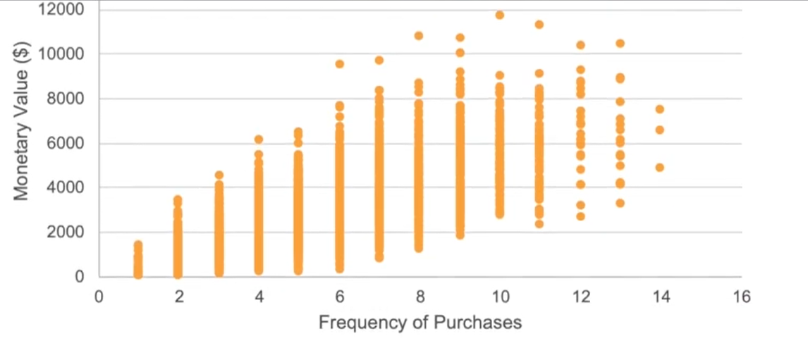
Model Development
Scatter Plot Based on RFM Analysis
Customer classified as “platinum customer”, ”very loyal” and “Becoming loyal” visit frequently, which correlated with increase revenue for the business.
There is positive relationship between Monitory and frequency of purchase .

Slide 10
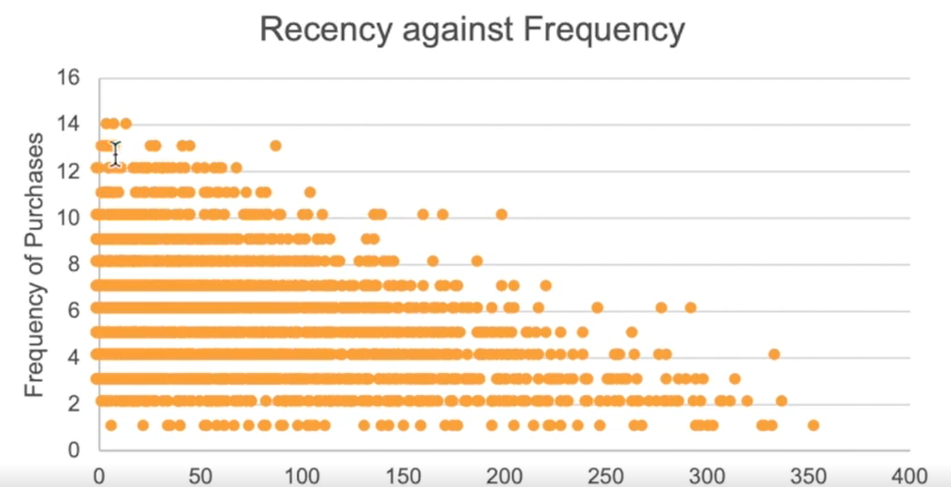
Model Development
Scatter Plot Based on RFM Analysis
Very low frequency of 0-2 correlated with high recency values which is more than 250 days ago.
Customers who visited more recently have a higher chance of visiting more frequently i.e 6 plus.
Higher frequency has a negative relationship with recency values.

Slide 11
Interpretation
Summary Table of Top 1000 Customers to Target
Rank | Customer title | Number of customer | Cumulative | Customer selection
1 | Platinum customer | 164 | 176 | 176
2 | Very loyal | 184 | 360 | 184
3 | Becoming loyal | 344 | 704 | 344
4 | Recent customer | 368 | 1072 | 296
5 | Potential customer | 355 | 1427 | 0
6 | Late bloomer | 333 | 1760 | 0
7 | Losing customer | 356 | 2116 | 0
8 | High risk customer | 360 | 2476 | 0
9 | Almost lost customer | 336 | 2802 | 0
10 | Evasive customer | 401 | 3203 | 0
11 | Lost customer | 290 | 3493 | 0

Slide 12
Interpretation
Customers Target and Methodology
Rank | Customer title | Number of customer | Cumulative | Customer selection
1 | Platinum customer | 164 | 176 | 176
2 | Very loyal | 184 | 360 | 184
3 | Becoming loyal | 344 | 704 | 344
4 | Recent customer | 368 | 1072 | 296
Filter through the top 1000 customer by assigning the condition discussed in the above table.
The 1000 customer discovered would have bought recently, they have bought very frequently in the past and tend to spend more than other customer.

Slide 13
Thank You

